Slide 1
Topics
What is Exception
Types of Exception
Dealing with Exception
  Throw an Exception
  Handling Exception
Structuring a Method with try-catch-finally blocks
Execution flow for Normal and Exception case
Rethrowing Exceptions
Throwable Object

Slide 2
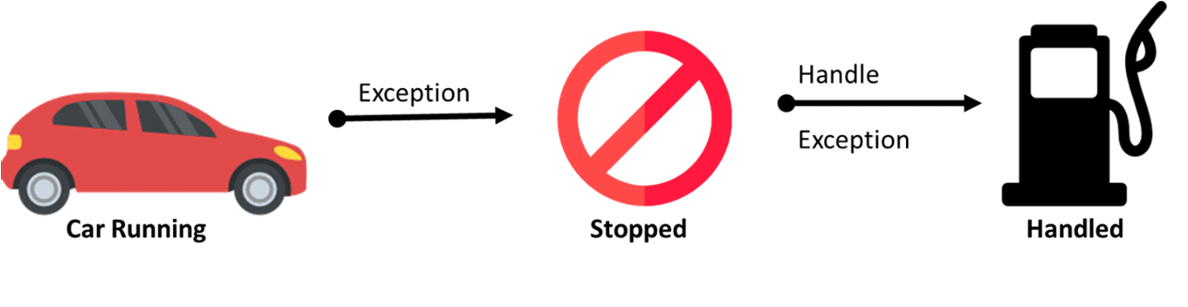

What is Exception
An exception usually signals an error.
An exception in Java is an object that’s created when an abnormal situation arises in your program.
This exception object has fields that store information about the nature of the problem.
The object identifying the exceptional circumstance is thrown as an argument to a specific piece of program code that has been written specifically to deal with that kind of problem.

Slide 3

What is Exception
Exception separates the code that deals with errors from
the code that is executed when things are moving along smoothly.
It provides a way of enforcing a response to particular
errors.

Slide 4
What is Exception
An exception can occur for many reasons. Some of them are:
Invalid user input
Device failure
Loss of network connection
Physical limitations (out of disk memory)
Code errors
Opening an unavailable file

Slide 5
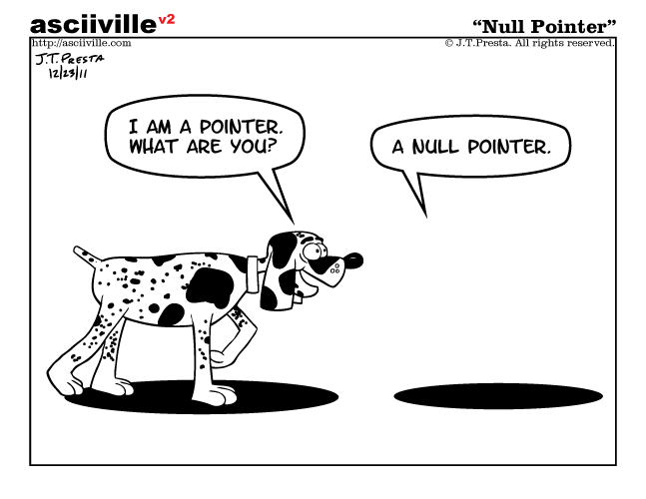
NullPointerException

Slide 6
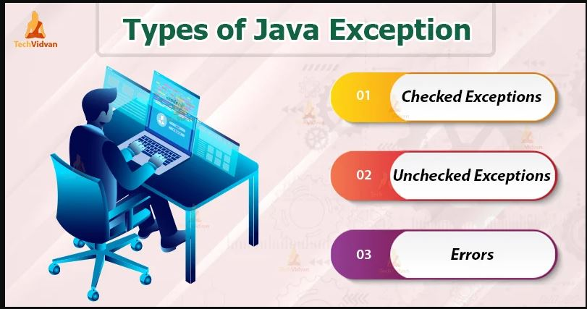
Types of Exception in Java

Slide 7
What is Exception
Throws exception
Method where the error occurred
Looking for appropriate handler
Forwards exception
Method without an exception handler
Looking for appropriate handler
Catches some other exception
Method with an exception
handler
m a i n
The exception handler chosen is said to catch the exception. If the runtime system exhaustively searches all the methods on the call stack without finding an appropriate exception handler, as shown in the next figure, the runtime system (and, consequently, the program) terminates.

Slide 8
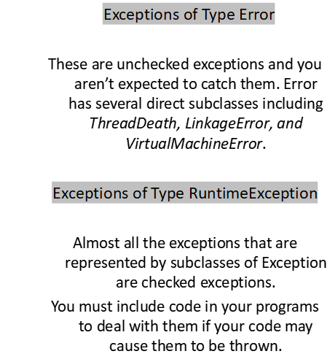
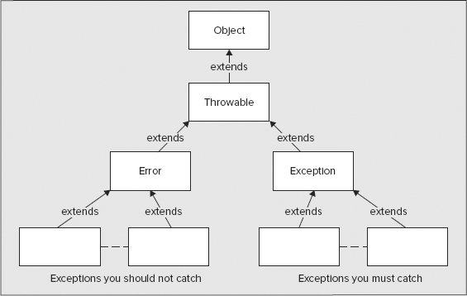
Types of Exception

Slide 9
Dealing with Exception
The try-catch is the simplest method of handling exceptions. Put the code you want to run in the try block, and any Java exceptions that the code throws are caught by one or more catch blocks.
This method will catch any type of Java exceptions that get thrown. This is the simplest mechanism for handling exceptions.
try {
// block of code that can throw exceptions
} catch (Exception ex) {
// Exception handler
}
Note: You can’t use a try block alone. The try block should be immediately followed either by a catch or finally block.

Slide 10
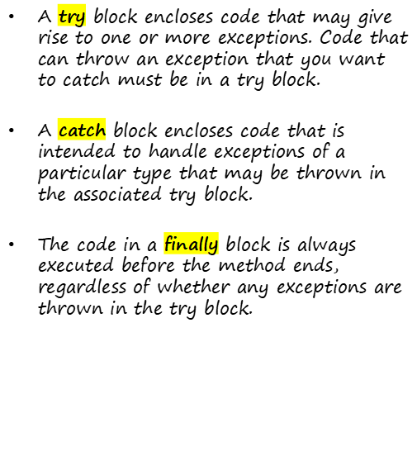
Handling Exception
public class ExceptionHandlingTest {
public static void main(String[] args) {
try {
dosomething();
} catch (Exception e) {
System.out.println(e.toString());
} finally {
System.out.println("Finally has been executed");
}
}
static void dosomething() throws Exception {
throw new Exception();
}
}

Slide 11
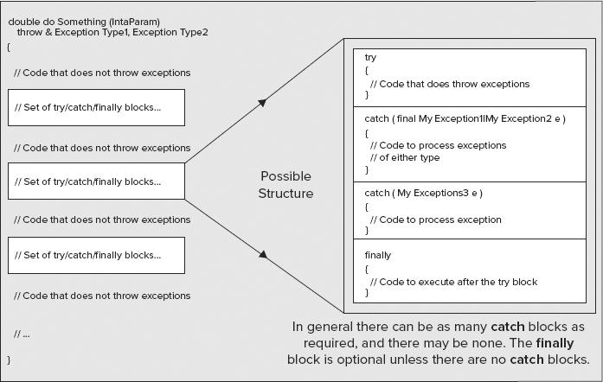
Structuring a Method

Slide 12
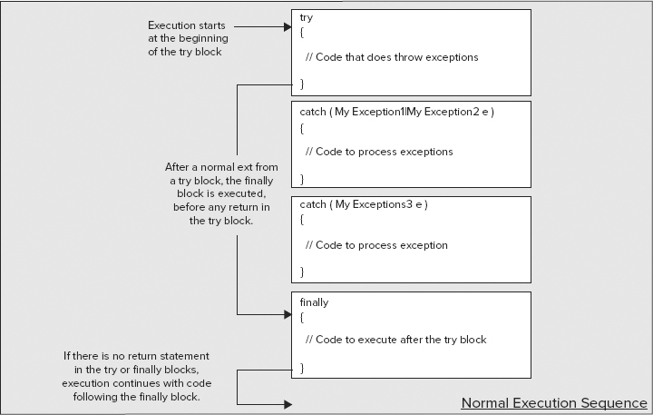
Normal Execution Sequence

Slide 13
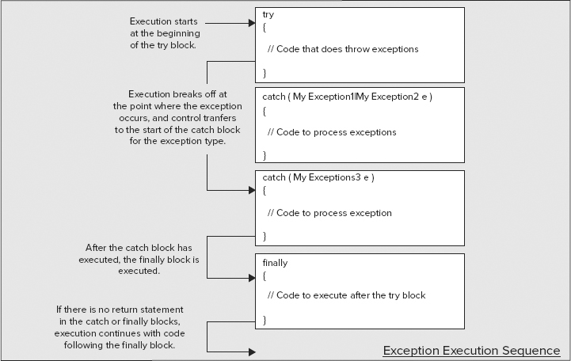
Exception Execution Sequence

Slide 14
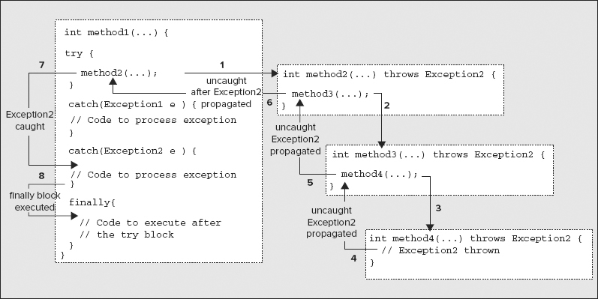
Execution When an Exception Is Not Caught
It shows method1()
calling method2(),
which calls method3(),
which calls method4(), in which an exception of type Exception2 is thrown.
This exception isn’t caught in method4(), so execution of method4() ceases, and the exception is thrown to method3().
It isn’t caught and continues to be thrown until it reaches method1() where there’s a catch block to handle it.

Slide 15
Execution When an Exception Is Not Caught
public class Exception1 extends Exception {
}
public class Exception2 extends Exception {
}
public class ExceptionHandlingTest {
public static void main(String[] args) {
method1();
}
static int method1() {
int k = 0;
try {
k = method2();
dosomething();
} catch (Exception1 e) {
System.out.println(e.toString());
} catch (Exception2 e) {
System.out.println(e.toString());
} finally {
System.out.println("Finally has been executed");
}
return k;
}
static int method2() throws Exception2 {
return method3();
}
static int method3() throws Exception2 {
return method4();
}
static int method4() throws Exception2 {
throw new Exception2();
}
static void dosomething() throws Exception1 {
throw new Exception1();
}
}

Slide 16
Execution When an Exception Is Not Caught
public class Exception1 extends Exception {
}
public class Exception2 extends Exception {
}
public class ExceptionHandlingTest {
public static void main(String[] args) throws Exception2,
Exception1 {
method1();
}
static int method1() throws Exception2, Exception1 {
int k = 0;
k = method2();
dosomething();
return k;
}
static int method2() throws Exception2 {
return method3();
}
static int method3() throws Exception2 {
return method4();
}
static int method4() throws Exception2 {
throw new Exception2();
}
static void dosomething() throws Exception1 {
throw new Exception1();
}
}

Slide 17
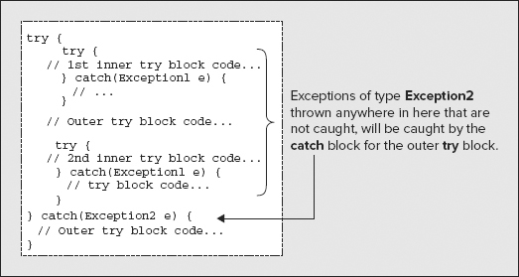
Nested try Blocks

Slide 18
Rethrowing an Exception
try {
// Code that originates an arithmetic exception
} catch(ArithmeticException e) {
// Deal with the exception here
throw e; // Rethrow the exception to the calling program
}
If you need to pass an exception that you have caught on to the calling program, you can rethrow it from within the catch block using a throw statement. For example:

Slide 19
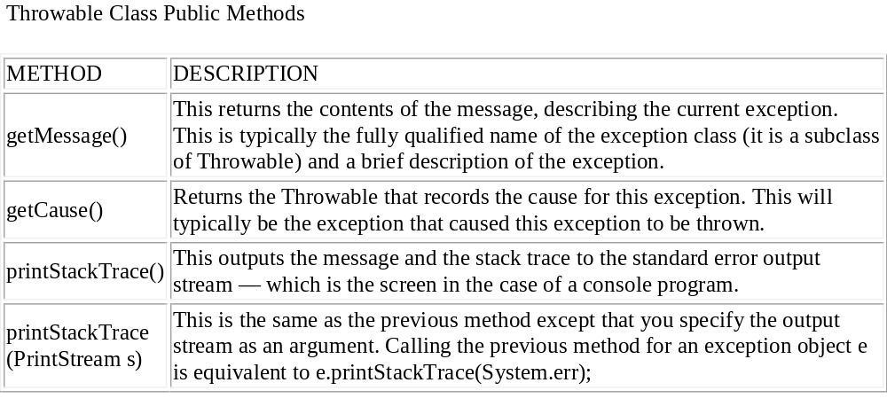
Exception Object
Exceptions are Throwable type object. Objects of type Throwable
can contain the following information:
A message, which I have just referred to as being initialized by a constructor.
A Throwable object identifies the cause of the exception.
A record of the execution stack at the time the object was created.
A record of exceptions suppressed in order to deliver this exception.

Slide 20
Exception Example
public class ExceptionHandlingTest {
public static int divide(int[] array, int index) {
try {
System.out.println("\nFirst try block in divide() entered");
array[index + 2] = array[index]/array[index + 1];
System.out.println("Code at end of first try block in divide()");
return array[index + 2];
} catch(ArithmeticException e) {
System.err.println("Arithmetic exception caught in divide()\n" +
"\nMessage in exception object:\n\t" + e.getMessage());
System.err.println("\nStack trace output:\n");
e.printStackTrace();
System.err.println("\nEnd of stack trace output\n");
} catch(ArrayIndexOutOfBoundsException e) {
System.err.println("Index-out-of-bounds exception caught in divide()\n"
+"\nMessage in exception object:\n\t" + e.getMessage());
System.err.println("\nStack trace output:\n");
e.printStackTrace();
System.out.println("\nEnd of stack trace output\n");
} finally {
System.err.println("finally clause in divide()");}
System.out.println("Executing code after try block in divide()");
return array[index + 2];
}
}

Slide 21
Exercises
Suppose EmployeeSearch which has a static list of employeeNameList and an instance method named getEmployee(int index) accordingly the given code snippet below.
Get the index from keyboard and get the employee Name of that index using getEmplyee(..) method.
public class EmployeeSearch {
static List<String> employeeNameList = new ArrayList<String>();
static {
//Add some names in list..
}
String getEmployee(int i){
//This instance method will take an int as index.
//This method throws SizeOutofBoundException
// if index is greater than size of list.
//This method throws NegativeSizeException
//if index is less than zero.
//If index is >=0 and less than size of list,
it will return the value of than index from the list.
}
}
public static void main(String[] args) {
// Get the index from keyboard
//and get the employee Name of that index
// using getEmplyee(..) method
// while calling getEmployee() method,
//handle all probable exceptions
// print that indexed name, or print the exceptions message.
}
}
public class SizeOutofBoundException extends Exception{}

